Slide 1
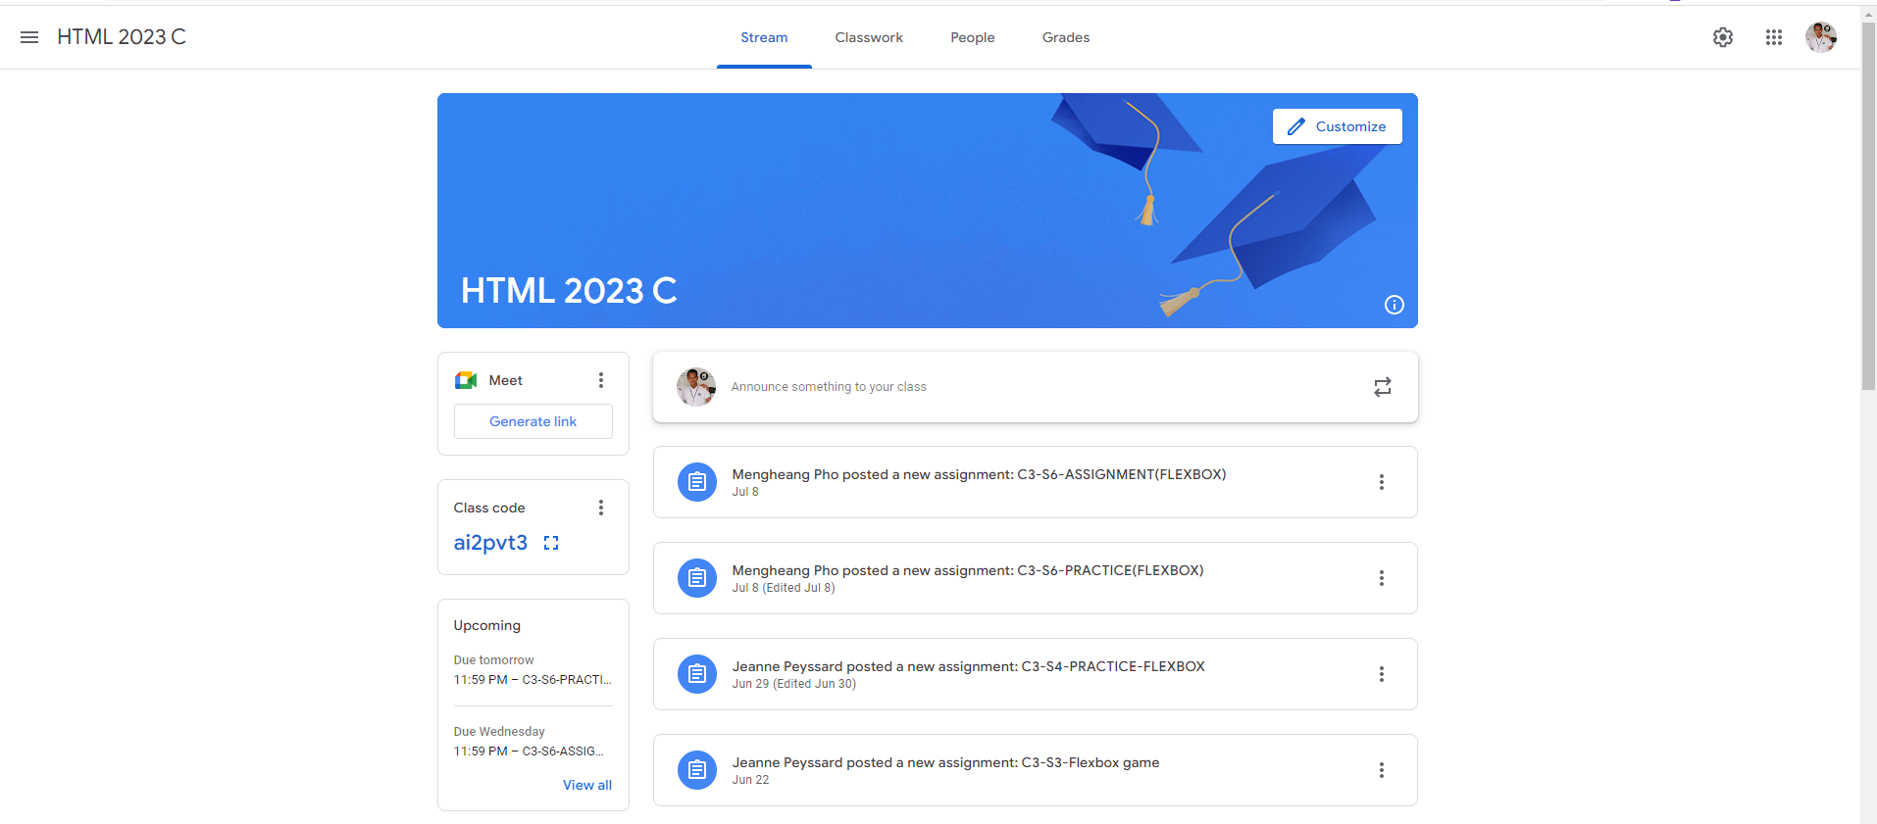
Identify root components of website below

Slide 2
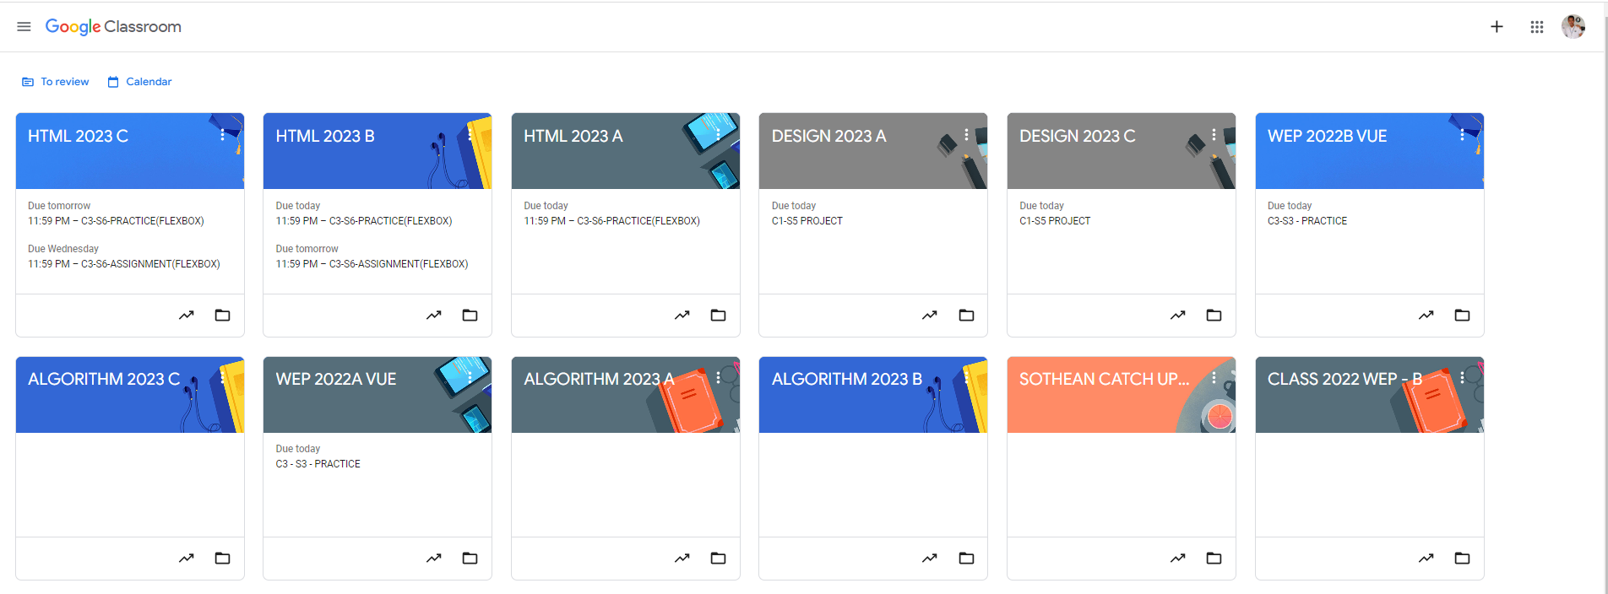
Root div
- Height: 100vh
content
nav
Flex: 0
header
Flex: 0
Flex: 1

Slide 3
Navigation
flex0
Flex-direction: row;
Nav-left
Nav-center
Nav-right
flex1
flex2
flex3
Flex-direction: column;
Header
Root
Section1
Section2
Main
Content

